Slide 1
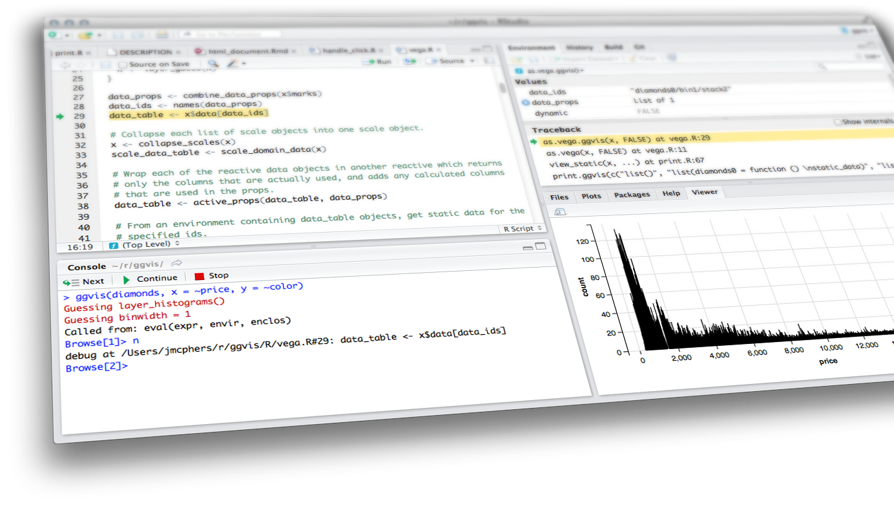
MODULES & bookmarking

Slide 2
Modules
Anatomy of a Shiny module
User interface
Server function
Calling the module
Packaging modules
Exercise: Modularize this!
Combining modules
Bookmarking
How to bookmark
Bookmarking options
Customizing bookmarks

Slide 3
What is a
Shiny module?

Slide 4
modules
A module is a self-contained, composable component of a Shiny app
self-contained like a function
can be combined to make an app
Have their own UI and server (in addition to the app UI and server)

Slide 5
Modules
Useful for reusability
rather than copy and paste code, you can use modules to help manage the pieces that will be repeated throughout a single app or across multiple apps
can be bundled into packages
Essential for managing code complexity in larger apps

Slide 6
limitations to just functionalizing
It’s possible to write UI-generating functions and call them from your app’s UI, and you write functions for the server that define outputs and create reactive expressions
However you must make sure your functions generate input and output IDs that don’t collide since input and output IDs in Shiny apps share a global namespace, meaning, each ID must be unique across the entire app
Solution: Namespaces! Modules add namespacing to Shiny UI and server logic

Slide 7
“The thing to keep in mind about defining shiny UI, is that the main tool for managing complexity is the same tool as everywhere else in R: the function. Since Shiny user interfaces are defined using function calls, take advantage of that fact by reusing and encapsulating UI creation logic into functions. The same can be said for defining server logic--write functions, and when those functions get too complicated, split them into more functions.”
–Joe Cheng, 7/9/2015

Slide 8
“Roughly, hygienic macro expansion is desirable for the same reason as lexical scope: both enable local reasoning about binding so that program fragments compose reliably.”
–Matthew Flatt

Slide 9
Shiny Modules
“Roughly, hygienic macro expansion is desirable for the same reason as lexical scope: both enable local reasoning about binding so that program fragments compose reliably.”
–Matthew Flatt

Slide 10
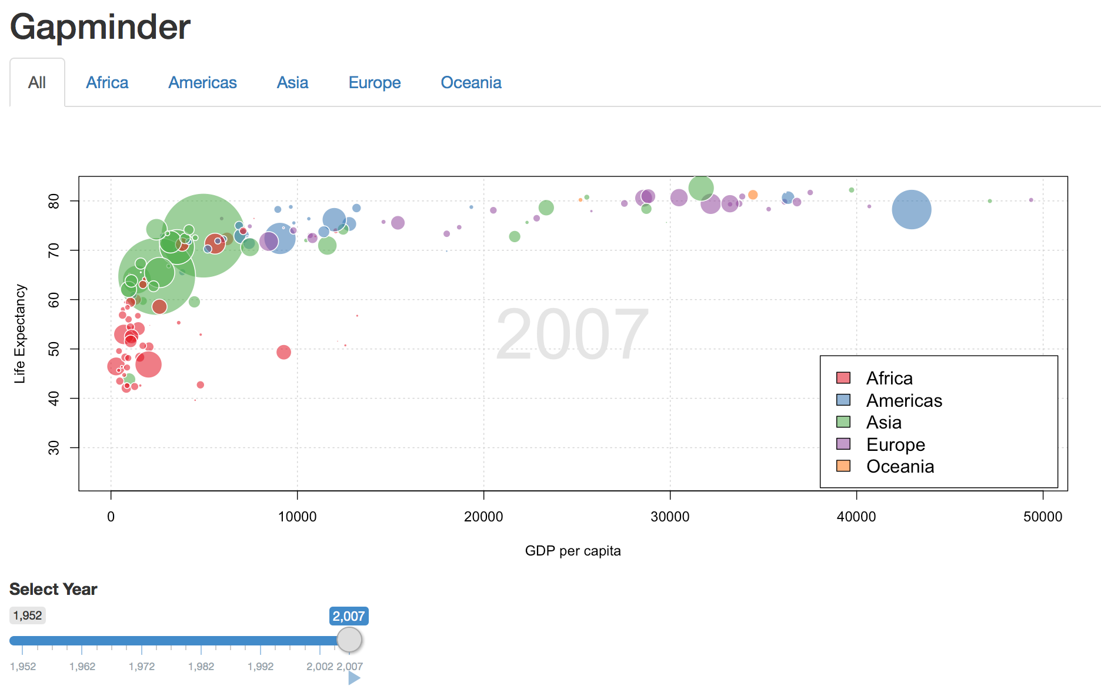


demo
gapminder_app.R
Same functionality
in each tab
Shiny from
© 2016 RStudio, Inc. All rights reserved.

Slide 11
Ladder of Progression
Step 1. Use modules to break large monolithic apps into manageable pieces
Step 2. Create reusable modules
Step 3. Nest modules

Slide 12
Anatomy of a
Shiny module

Slide 13
what’s in a module?
User interface
controls the layout and appearance of module
library(shiny)
name_of_module_UI <- function(id, label = "Some label") {
# Create a namespace function using the provided id
ns <- NS(id)
# UI elements go here
tagList(
…
)
}
name_of_module <- function(input, output, session, …) {
# Server logic goes here
}
Server function
contains instructions
needed to build module

Slide 14
module vs. app
Similarities:
Inputs in UI can be accessed in server with input$
Outputs in UI can be defined in server with output$
Differences:
Inputs/outputs cannot be directly accessed from outside the module namespace
If a module needs to use a reactive expression, take the reactive expression as a function parameter. If a module wants to return reactive expressions to the calling app, then return a list of reactive expressions from the function
If a module needs to access an input that isn’t part of the module, the containing app should pass the input value wrapped in a reactive expression

Slide 15
User interface

Slide 16
module ui
A function
Takes, as input, an id that gets pre-pended to all HTML element ids with a helper function: NS()
Can also have additional parameters

Slide 17
Server function

Slide 18
module server
Includes the code needed for your module
Looks almost identical to the app server function, except that you may have additional parameters
App server function is automatically invoked by Shiny; module server function must be invoked by the app author

Slide 19
Calling the module

Slide 20
calling the module in your app
In the app UI:
Include the module UI with name_of_module_UI("id", …)
Can also include other UI elements that are not included in the module
In the app server:
Include the module server with callModule(name_of_module, "id", …)
Can also include other UI elements that are not included in the module
The id must match and must be unique among other inputs/outputs/modules at the same "scope" (either top-level ui/server, or within a parent Shiny module)

Slide 21
demo
gapminder.R
ui:
server:
ui <- fluidPage(
…
titlePanel("Gapminder"),
tabsetPanel(id = "continent",
tabPanel("All", gapModuleUI("all")),
tabPanel("Africa", gapModuleUI("africa")),
tabPanel("Americas", gapModuleUI("americas")),
tabPanel("Asia", gapModuleUI("asia")),
tabPanel("Europe", gapModuleUI("europe")),
tabPanel("Oceania", gapModuleUI("oceania"))
)
)
server <- function(input, output) {
callModule(gapModule, "all", all_data)
callModule(gapModule, "africa", africa_data)
callModule(gapModule, "americas", americas_data)
callModule(gapModule, "asia", asia_data)
callModule(gapModule, "europe", europe_data)
callModule(gapModule, "oceania", oceania_data)
}
Shiny from
© 2016 RStudio, Inc. All rights reserved.
Notes:
Launch app and show that gapminder.R has very little code in it and all the plotting is handling by the module and repeated across tabs

Slide 22
Packaging modules

Slide 23
Packaging modules
Inline code: Put the UI and server function code of the module directly in your app
If using app.R (single-file) syle, include module code in that file, before the app’s UI and server logic
If using ui.R / server.R (two-file) style, include module code in the global.R file
If defining many modules / modules containing a lot of code, may result in bloated global.R/app.R file.
Standalone R file:
Save module code in a separate .R file and then call source("path-to-module.R") from app.R or global.R
Probably the best approach for modules that won’t be reused across applications
R package: Useful if your modules are intended to be reused across apps
R package needs to export and document your module’s UI and server functions
R packages can include more than one module

Slide 24
Modularize
this!

Slide 25

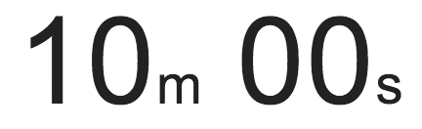
exercise
See movies_20.R for a simpler version of the movie browser:
only select x, y, and z (for colors) variables
and alpha level and size of points
three tabs: one for each title type, showing a scatterplot and data table
Note that this app is created by repeating the plotting and data table code chunks three times each
Modularize the app using moviesmodule_template.R
Shiny from
© 2016 RStudio, Inc. All rights reserved.

Slide 26
Solution
App: movies_21.R
Module: moviesmodule.R
Shiny from
© 2016 RStudio, Inc. All rights reserved.

Slide 27
Combining
modules

Slide 28
Combining modules
When building an app that uses modules that depend on each other, avoid violating the sanctity of the module's namespace (similar to a function's local environment)
If results of Module 1 will be used as inputs in Module 2, then Module 1 needs to return those results as an output, so that Module 2 does not have to “reach in and grab them”

Slide 29
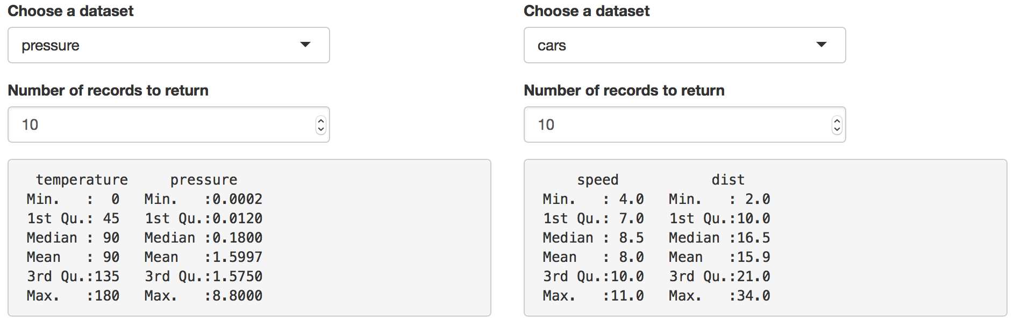
demo
left_right_01.R
Shiny from
© 2016 RStudio, Inc. All rights reserved.
Notes:
Clearly actions are repeated on the left and right for different datasets, so make use of modules

Slide 30
demo
Module 1: Dataset chooser
# Module 1 UI
dataset_chooser_UI <- function(id) {
ns <- NS(id)
tagList(
selectInput(ns("dataset"), "Choose a dataset", c("pressure", "cars")),
numericInput(ns("count"), "Number of records to return", 10)
)
}
# Module 1 Server
dataset_chooser <- function(input, output, session) {
dataset <- reactive({
req(input$dataset)
get(input$dataset, pos = "package:datasets")
})
return(list(
dataset = dataset,
count = reactive(input$count)
))
}
Why not dataset()?
Why wrapped with reactive()?
Shiny from
© 2016 RStudio, Inc. All rights reserved.

Slide 31
demo
Module 2: Dataset summarizer
# Module 2 UI
dataset_summarizer_UI <- function(id) {
ns <- NS(id)
verbatimTextOutput(ns("summary"))
}
# Module 2 Server
dataset_summarizer <- function(input, output, session, dataset, count) {
output$summary <- renderPrint({
summary(head(dataset(), count()))
})
}
Shiny from
© 2016 RStudio, Inc. All rights reserved.

Slide 32
App combining the two modules
demo
# App UI
ui <- fluidPage(
fluidRow(
column(6,
dataset_chooser_UI("left_input"),
dataset_summarizer_UI("left_output")
),
column(6,
dataset_chooser_UI("right_input"),
dataset_summarizer_UI("right_output")
)
)
)
# App server
server <- function(input, output, session) {
left_result <- callModule(dataset_chooser, "left_input")
right_result <- callModule(dataset_chooser, "right_input")
callModule(dataset_summarizer, "left_output",
dataset = left_result$dataset, count = left_result$count)
callModule(dataset_summarizer, "right_output",
dataset = right_result$dataset, count = right_result$count)
}
Shiny from
© 2016 RStudio, Inc. All rights reserved.
Notes:
Save the results of Module 1 as a list, then use those in Module 2

Slide 33
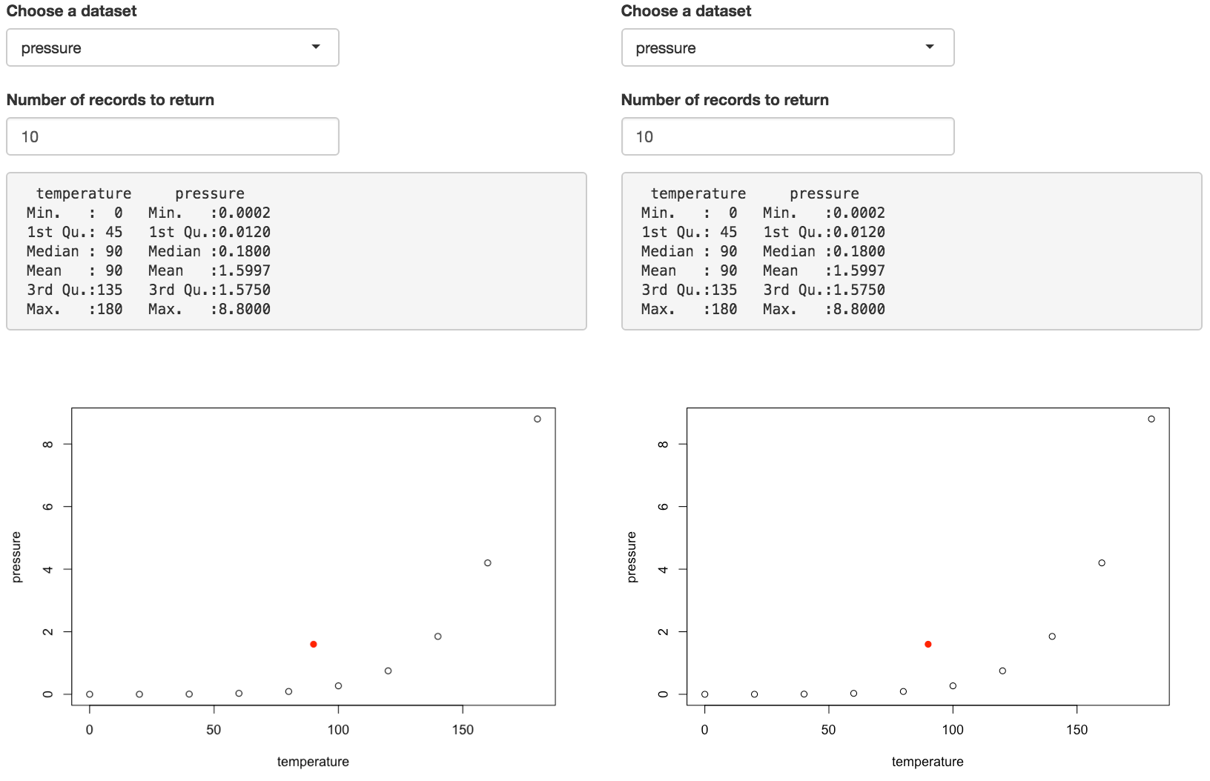
exercise
Start with left_right_01.R
Update the 2nd module, dataset summarizer, so that it also returns mean of each of the two variables
Add a 3rd module, dataset plotter, that makes a scatterplot of the selected dataset, and overlays a red point at (mean of x, mean of y) that it takes from the results of the dataset summarizer
Add this module into your app such that the plot is printed underneath the summary
Desired outcome:
Shiny from
© 2016 RStudio, Inc. All rights reserved.

Slide 34
Solution
Module 2: Dataset summarizer (updated)
# Module 2 UI
dataset_summarizer_UI <- function(id) {
ns <- NS(id)
verbatimTextOutput(ns("summary"))
}
# Module 2 Server
dataset_summarizer <- function(input, output, session, dataset, count) {
selected_data <- reactive({ head(dataset(), count()) })
output$summary <- renderPrint({
summary( selected_data() )
})
mean_x <- reactive({ mean(selected_data()[,1]) })
mean_y <- reactive({ mean(selected_data()[,2]) })
return(list(
mean_x = mean_x,
mean_y = mean_y
))
}
Shiny from
© 2016 RStudio, Inc. All rights reserved.

Slide 35
Solution
Module 3: Dataset plotter (new)
# Module 3 UI
dataset_plotter_UI <- function(id) {
ns <- NS(id)
plotOutput(ns("scatterplot"))
}
# Module 3 Server
dataset_plotter <- function(input, output, session, dataset, count,
mean_x, mean_y) {
output$scatterplot <- renderPlot({
plot(head(dataset(), count()))
points(x = mean_x(), y = mean_y(), pch = 19, col = "red")
})
}
Shiny from
© 2016 RStudio, Inc. All rights reserved.

Slide 36
Solution
App combining all three modules
See left_right_02.R for details
Shiny from
© 2016 RStudio, Inc. All rights reserved.

Slide 37
bookmarking

Slide 38
Motivation

Slide 39
motivation
Capture the results you're currently seeing in a Shiny app, by snapshotting inputs and state
Creates a URL that can be shared with others, or bookmarked for your own future use
Applications:
Collaboration across researchers: Biostatistician creates an app, passes on to the biologist to explore, biologist wants to communicate specific findings back to the biostatistician
Sharing results with a coworker/manager: Instead of sending someone to your app and then asking them to click this, check that, choose this, etc.
Education:
If using a Shiny app to teach concepts, students might be asked to play around with a distribution by tweaking inputs, and submit the output
Or an instructor might want to provide multiple scenarios in an app for students to explore

Slide 40
How to
bookmark

Slide 41
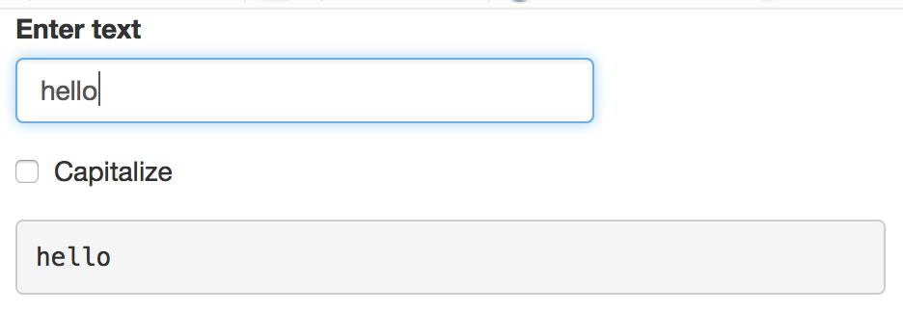
A very simple app
ui <- fluidPage(
textInput("txt", "Enter text"),
checkboxInput("caps", "Capitalize"),
verbatimTextOutput("out")
)
server <- function(input, output, session) {
output$out <- renderText({
ifelse(input$caps, toupper(input$txt), input$txt)
})
}
shinyApp(ui, server)

Slide 42
Enabling bookmarking
UI portion must be a function that takes one argument
ui <- function(request) {
fluidPage(
textInput("txt", "Enter text"),
checkboxInput("caps", "Capitalize"),
verbatimTextOutput("out"),
bookmarkButton()
)
}
server <- function(input, output, session) {
output$out <- renderText({
ifelse(input$caps, toupper(input$txt), input$txt)
})
}
shinyApp(ui, server, enableBookmarking = "url")
A button for bookmarking
There must be a call to enableBookmarking()

Slide 43
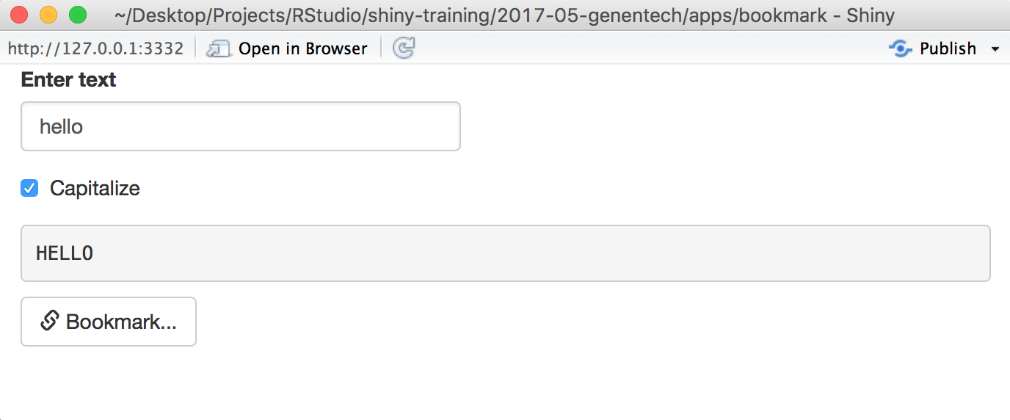
demo
bookmark_01.R
© 2016 RStudio, Inc. All rights reserved.

Slide 44
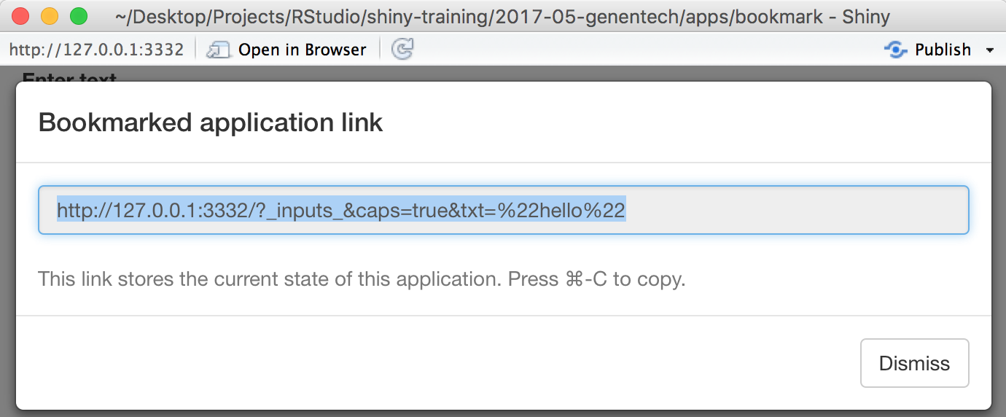
demo
bookmark_01.R
© 2016 RStudio, Inc. All rights reserved.

Slide 45
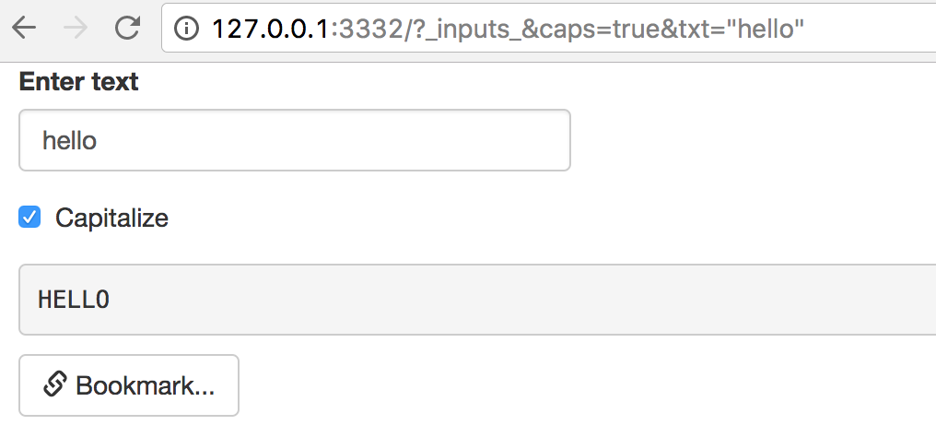
demo
bookmark_01.R
© 2016 RStudio, Inc. All rights reserved.

Slide 46
how bookmarking works
Bookmarked state automatically saves the input values (except passwords) such that when the application is restored using that state, the inputs are seeded with the saved values
File inputs are saved only when state is saved to server (not with URL encoding)

Slide 47
Bookmarking
options

Slide 48
types of bookmarking
URL-encoded | Saved-to-server
No state on server | State saved on server
URLs may be long & values revealed in URL | Always a short URL
URL length limits data (~2K characters on some browsers) | No limits on data
Can’t store uploaded files | Can store uploaded files
Best for simple apps without too much state to serialize | Appropriate for large amounts of state, incl files and directories if necessary

Slide 49
Enabling bookmarking
ui <- function(request) {
fluidPage(
textInput("txt", "Enter text"),
checkboxInput("caps", "Capitalize"),
verbatimTextOutput("out"),
bookmarkButton()
)
}
server <- function(input, output, session) {
output$out <- renderText({
ifelse(input$caps, toupper(input$txt), input$txt)
})
}
shinyApp(ui, server, enableBookmarking = "server")
Only change for saving to server

Slide 50
DEPLOYED EXAMPLES
URL-encoded
https://gallery.shinyapps.io/113-bookmarking-url/
https://gallery.shinyapps.io/113-bookmarking-url/?_inputs_&n=200

Slide 51
Customizing
bookmarks

Slide 52
excluding inputs
Inputs that should not be bookmarked can be excluded with setBookmarkExclude() in the server function, which takes in a vector containing the names of the inputs
server <- function(input, output, session) {
setBookmarkExclude(c("x", "y"))
}

Slide 53
multiple tabs
It is possible to bookmark which tab in a tabset is active
This requires providing IDs for tabsetPanel(), navbarPage(), or navlistPanel()
If you have multiple tabs, you likely want the bookmark button to show up on each tab
This also requires providing IDs for bookmarkButton(), and also excluding the bookmarking of the bookmark buttons themselves

Slide 54
demo
bookmark_02.R
Two tabs with checkboxes,
and bookmark button on each tab
server <- function(input, output, session) {
# Need to exclude the buttons from themselves being bookmarked
setBookmarkExclude(c("bookmark1", "bookmark2"))
# Trigger bookmarking with either button
observeEvent(input$bookmark1, {
session$doBookmark()
})
observeEvent(input$bookmark2, {
session$doBookmark()
})
}
To trigger bookmarking from each button, use observeEvent() for each button that calls session$doBookmark().
© 2016 RStudio, Inc. All rights reserved.

Slide 55
input dependence
Fully input-dependent apps: The state of the outputs at time t is fully determined by the state of the inputs at time t
Bookmarking should “just work”
Partly input-dependent apps: The state of the outputs at time t is only partly determined by the state of the inputs at time t — other things may influence it, including inputs at previous times, or external data
These apps are not fully reactive
Bookmarking requires additional tools to save & restore desired state

Slide 56
demo
bookmark_03.R
Displays the sum of all previous slider values added
ui <- fluidPage(
sidebarPanel(
sliderInput("n", "Value to add", min = 0, max = 100, value = 50),
actionButton("add", "Add"),
),
mainPanel(
h4("Sum:", textOutput("sum"))
)
)
server <- function(input, output, session) {
vals <- reactiveValues(sum = 0)
observeEvent(input$add, {
vals$sum <- vals$sum + input$n
})
output$sum <- renderText({
vals$sum
})
}
shinyApp(ui, server, enableBookmarking = "url")
State of output not fully determined by state of inputs since previous input values matter as well
Each time “Add” button is clicked, add input$n to vals$sum, then render text of the sum value
© 2016 RStudio, Inc. All rights reserved.

Slide 57
demo
ui <- function(request) {
fluidPage(
sidebarPanel(
sliderInput("n", "Value to add", min = 0, max = 100, value = 50),
actionButton("add", "Add"),
),
mainPanel(
h4("Sum:", textOutput("sum"))
)
bookmarkButton()
)
}
server <- function(input, output, session) {
vals <- reactiveValues(sum = 0)
onBookmark(function(state) {
state$values$currentSum <- vals$sum
})
onRestore(function(state) {
vals$sum <- state$values$currentSum
})
observeEvent(input$add, {
vals$sum <- vals$sum + input$n
})
output$sum <- renderText({
vals$sum
})
}
shinyApp(ui, server, enableBookmarking = "url")
bookmark_04.R
When app is bookmarked,
save vals$sum in the
bookmark state values
When app is restored,
retrieve vals$sum from the bookmark state values
© 2016 RStudio, Inc. All rights reserved.

Slide 58
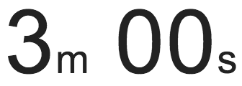
exercise
Run bookmark_04.R
There is a bug, what is it?
Can you fix it?
© 2016 RStudio, Inc. All rights reserved.

Slide 59
Solution
Solution to the previous exercise
bookmark_05.R
© 2016 RStudio, Inc. All rights reserved.

Slide 60
bookmarking

